Slide 1
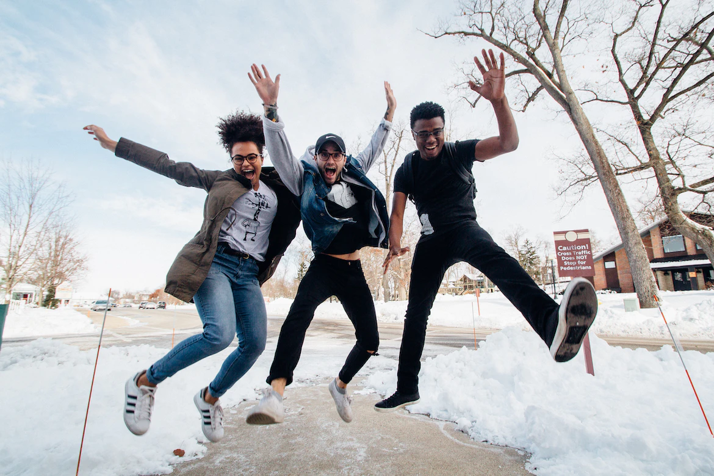

Racial Justice Sunday

Slide 2
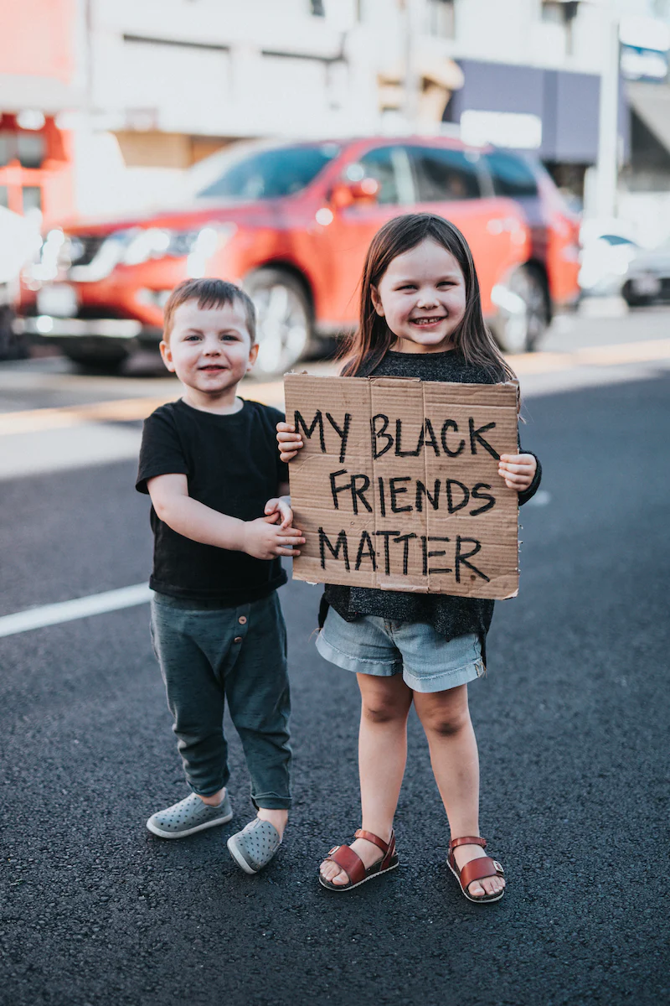
What do we mean by race?
What does it mean to be just or fair?
Before we begin…

Slide 3
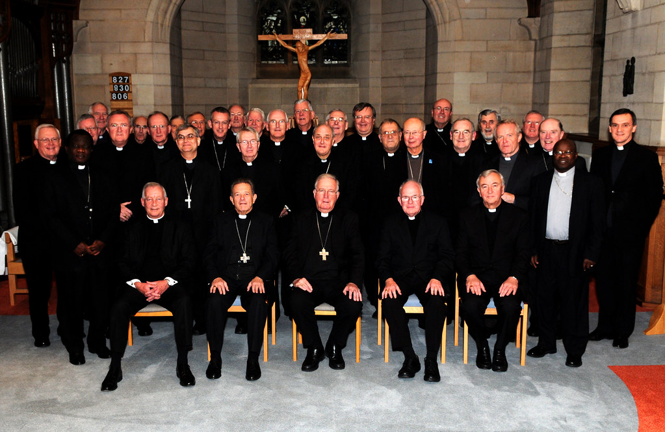
This year the bishops in our country said that we should …
“Walk together,
pray together
and
work together”
Think: Why is this important?

Slide 4
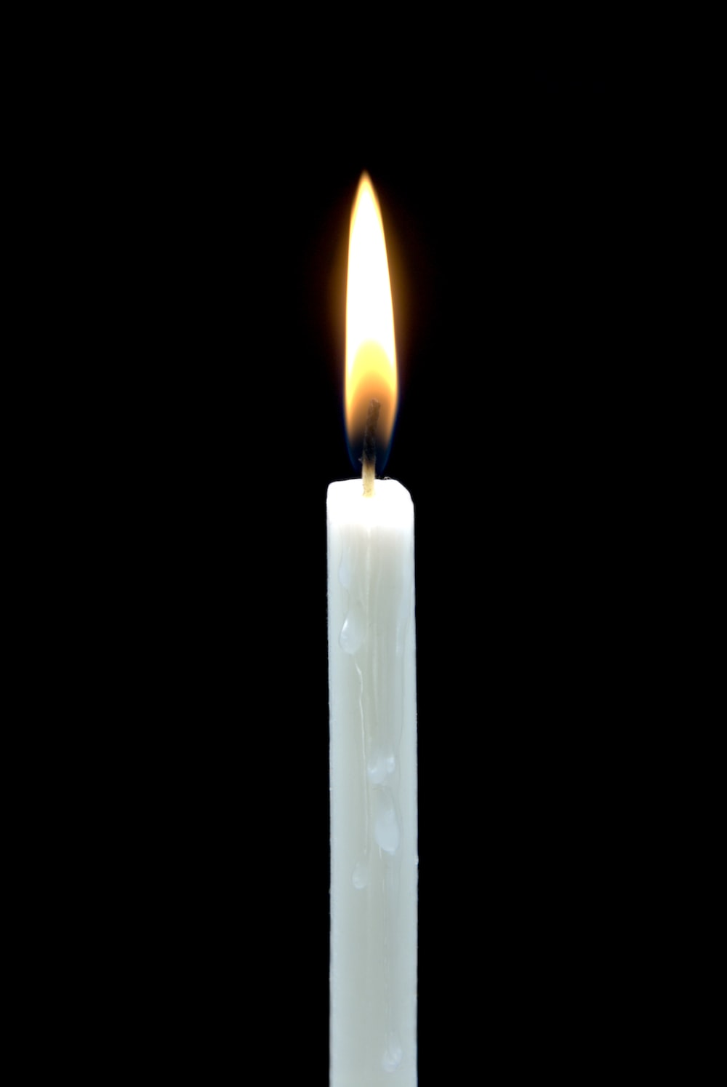
As we gather together,
we pray for all those
who have suffered
because of people’s racist actions.
Help us to make good choices
so that we can walk together, pray together and work together
with people of all races.
Help us to show God’s love
to everyone.
Amen
Gather

Slide 5
Jesus said to his disciples: ‘You are the salt of the earth. But if salt becomes tasteless, what can make it salty again? It is good for nothing, and can only be thrown out to be trampled underfoot.
You are the light of the world. A city built on a hill-top cannot be hidden. No-one lights a lamp to put it under a tub; they put it on the lamp-stand where it shines for everyone in the house. In the same way your light must shine in the sights of me, so that, seeing your good works, they may give the praise to your Father in heaven’.
Listen (Matthew 5:13-16)

Slide 6
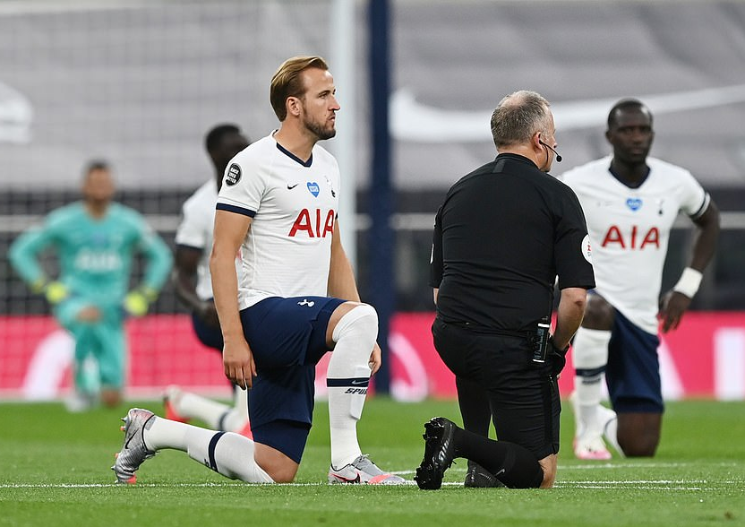
How can you be ‘salt’ and ‘light’ and make the world a fairer place for all God’s people?
Reflect

Slide 7
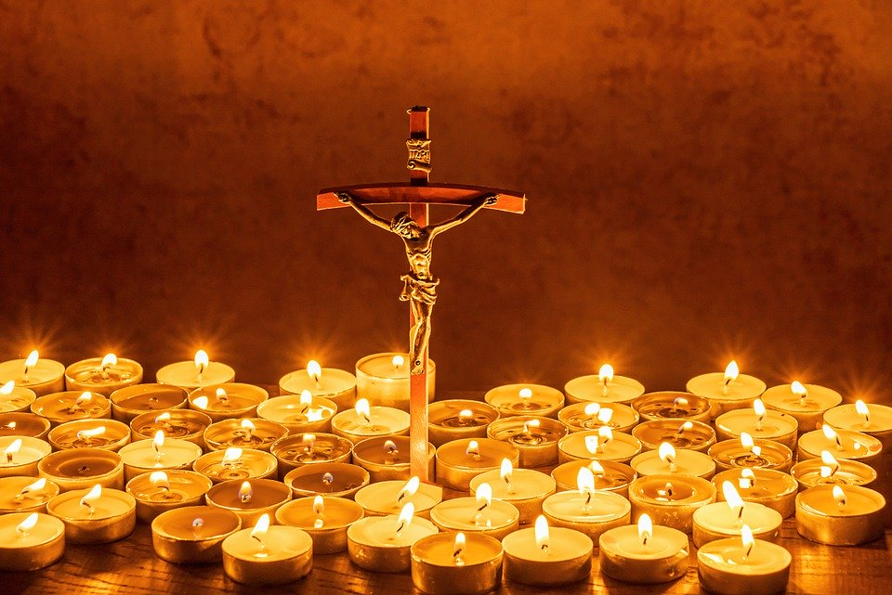
Let us pray

Slide 8
We pray for people of all races, that they will be treated justly
Lord hear us…
We pray for those who have or are suffering because of unfairness or racial injustice.
Lord hear us…

Slide 9
We pray for the leaders in our country that they will act now to bring about change for the better.
Lord hear us…
We pray that we will follow the example of Jesus by walking, praying and working together.
Lord hear us…
Our Father…

Slide 10

In your tutor/form time complete an activity from the pack based on the theme, and then live this out in your life:
Walking, praying and working together
Mission

Slide 11
Consider:
Creating a class or school display and then sending a photo to your Diocesan Adviser with a brief description of who you are and what you did.
Mission

