Slide 1
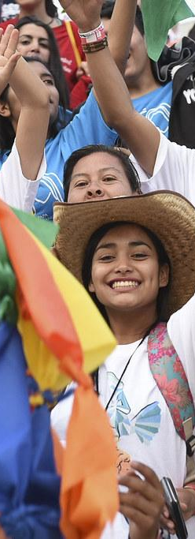
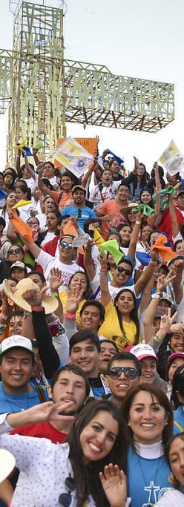
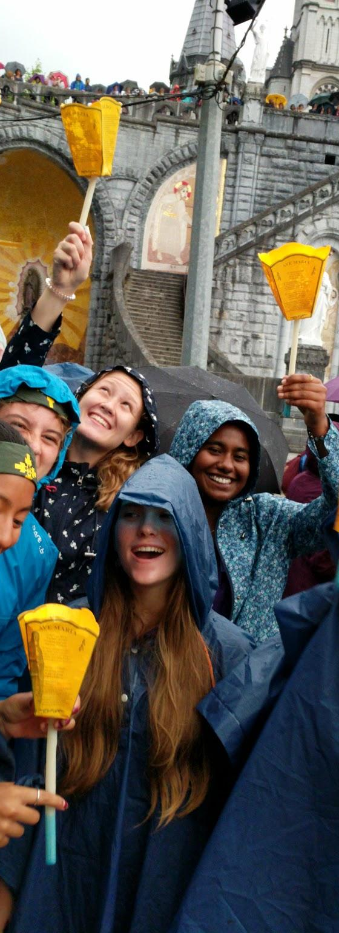
YOU WERE BORN SIGNIFICANT
National Youth Sunday • 24/11

Slide 2

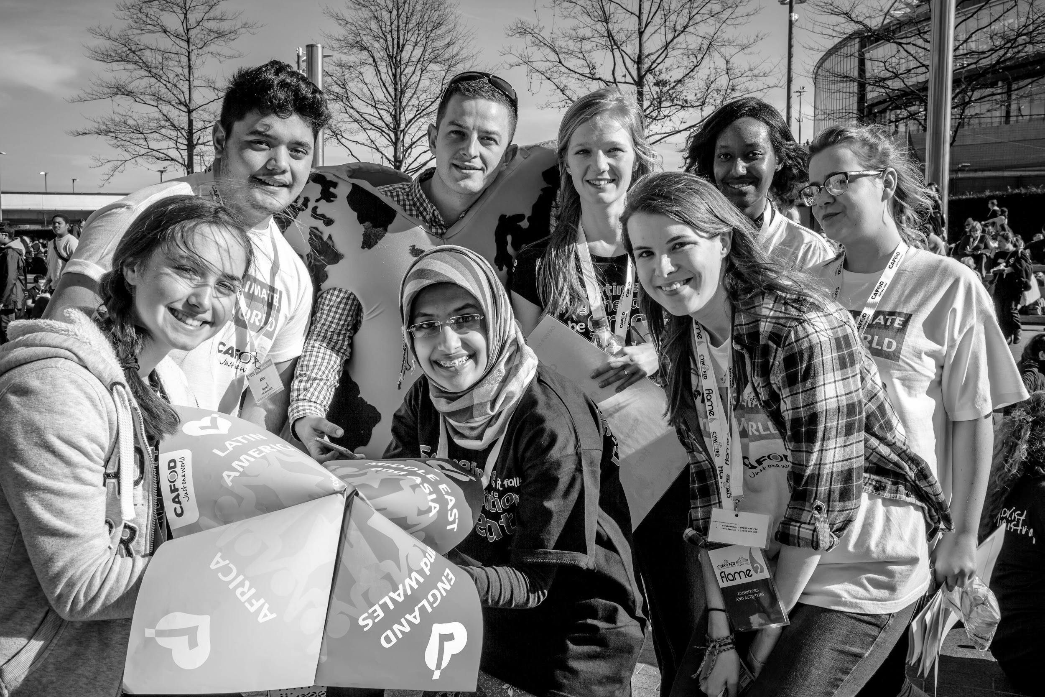
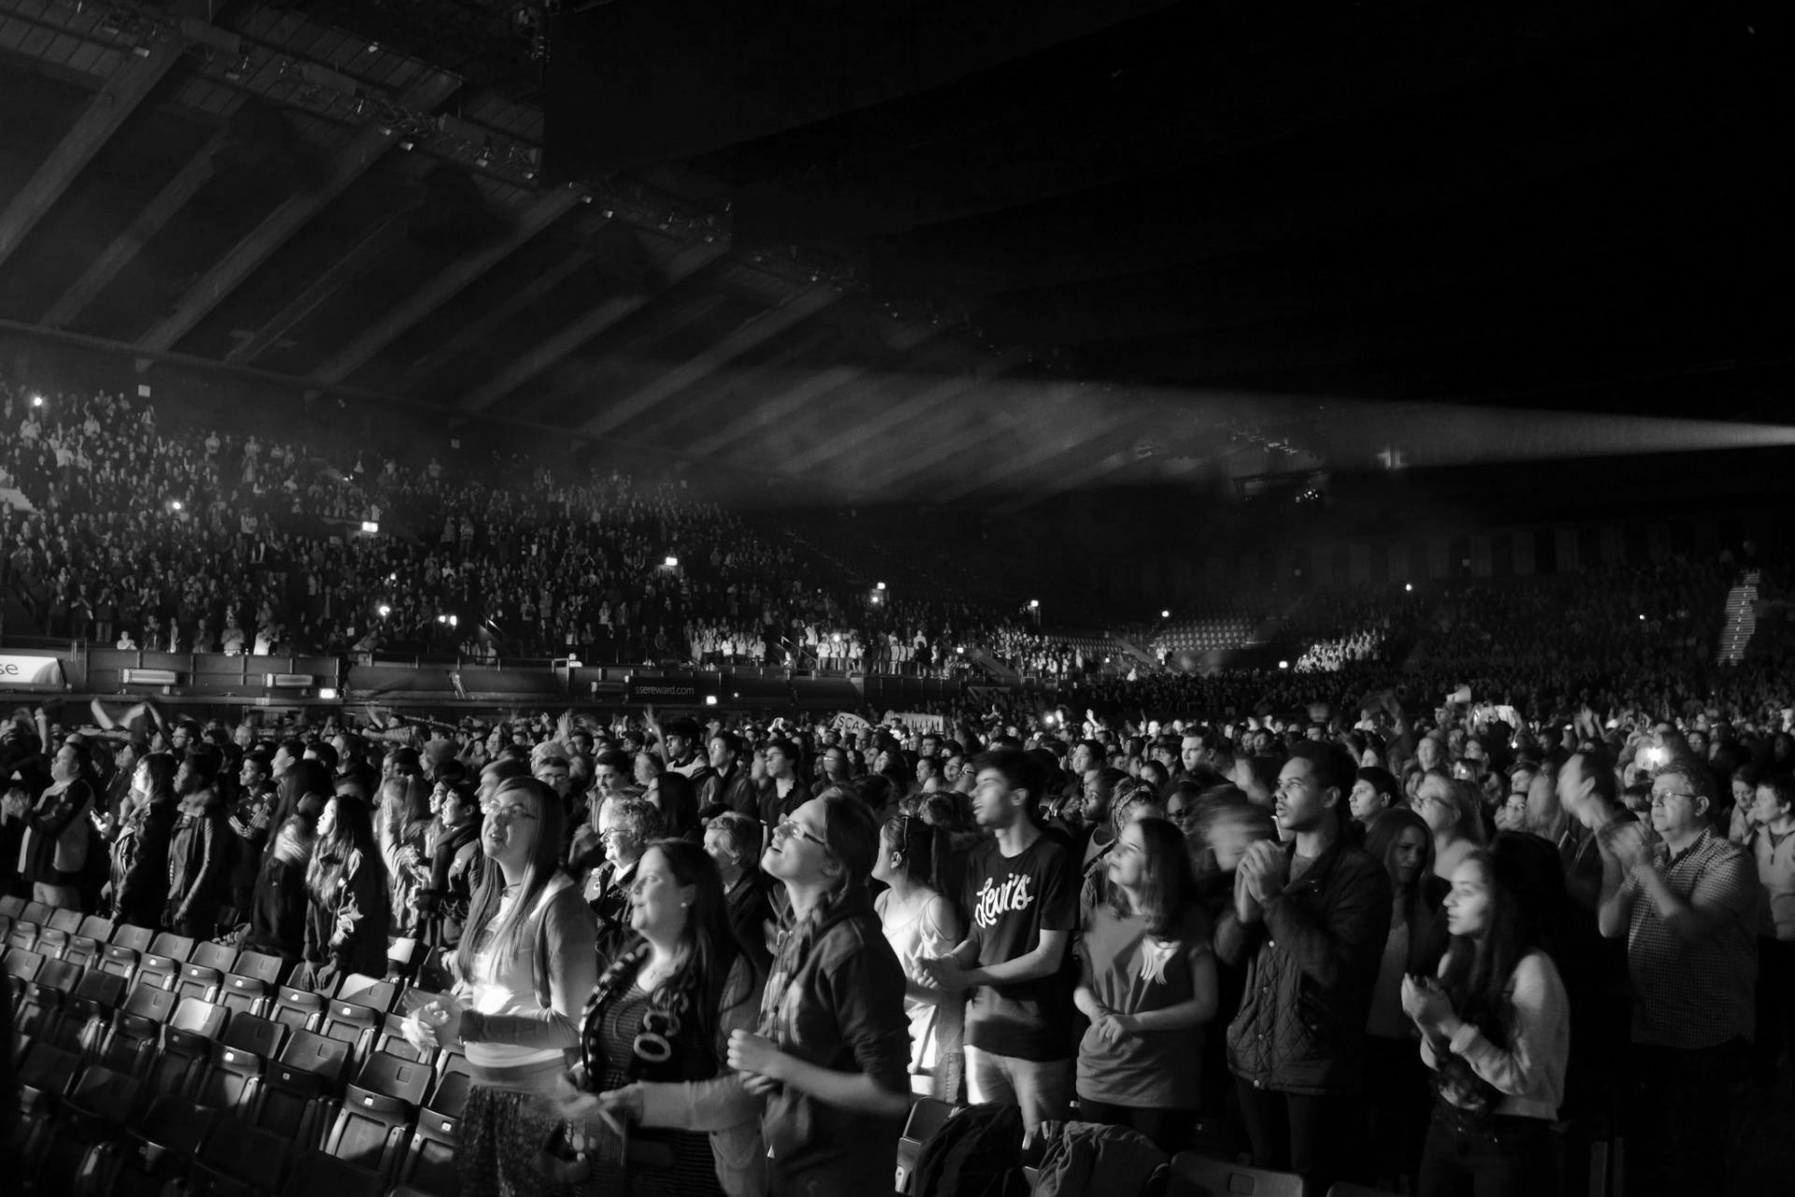
National Youth Sunday 2019
The Feast of Christ The King
Significance
Notes:
After the Sign of the Cross - start with a simple introduction the day, it’s aims, it’s purpose and its importance. You could read some of its aims and objectives or simply talk about the importance of young people in the Church.
This years theme is significance and it follows on from Flame - the largest gathering of Catholic Young People in the country.
It’s a reminder that we are all special, chosen and important to God.

Slide 3
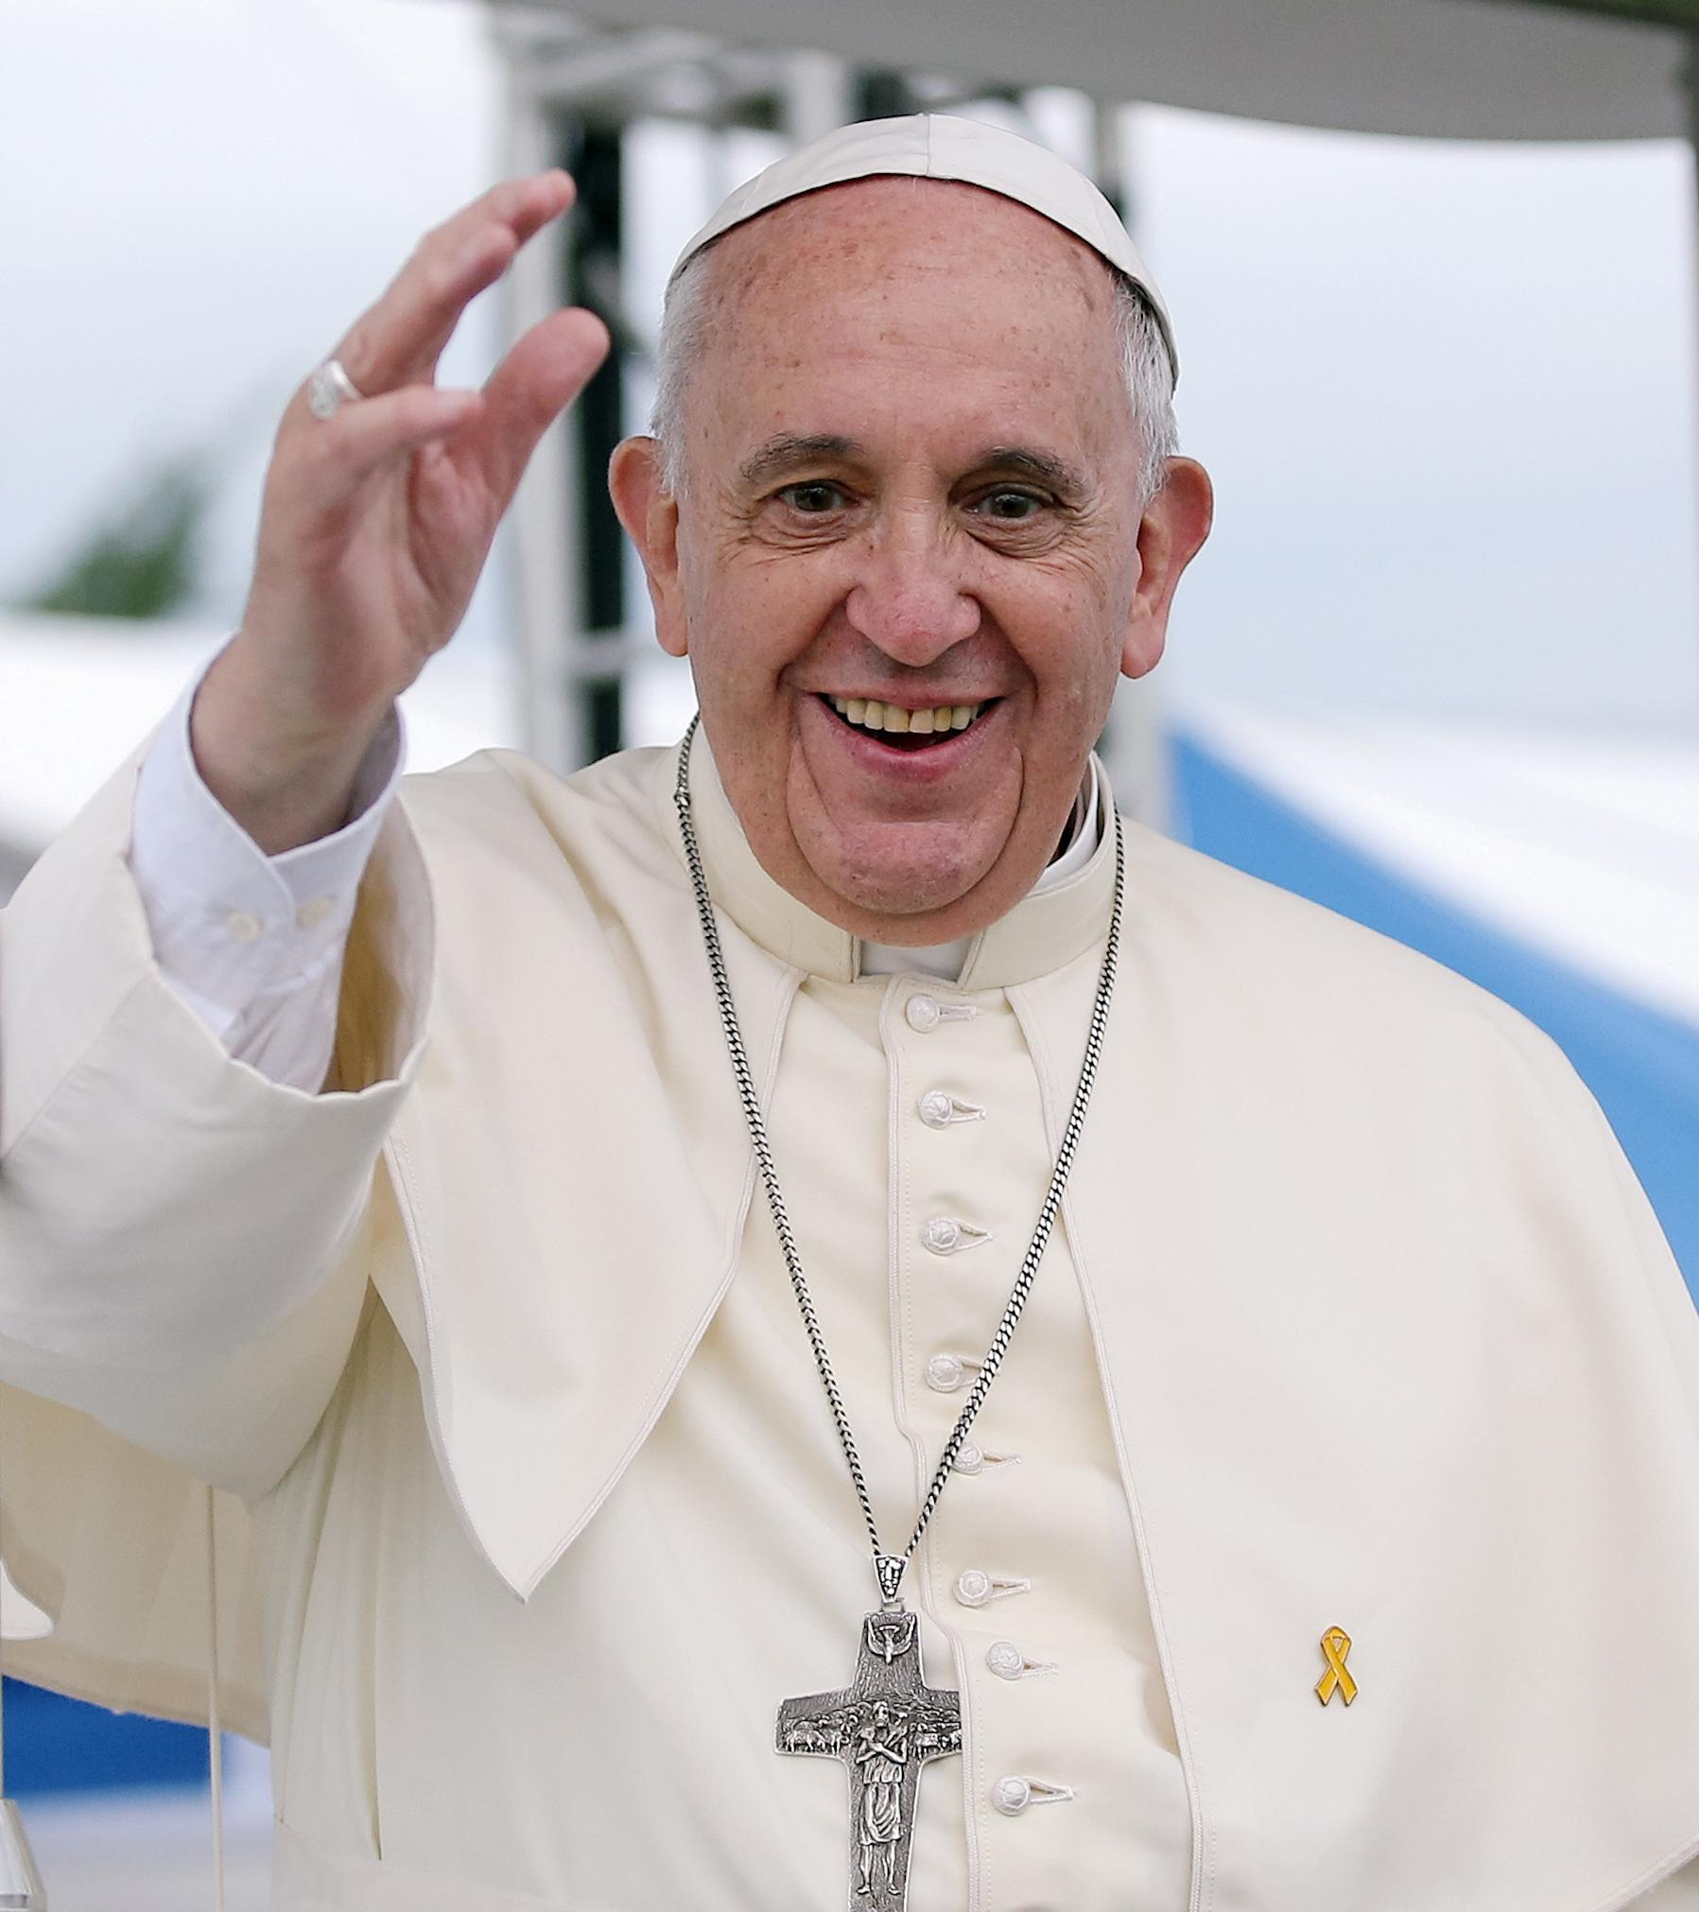
“For him, you have worth; you are not insignificant. You are important to him, for you are the work of his hands.”
Christus Vivit 115
Notes:
Pope Francis said this quote in Christus Vivit, his Apostolic Exhortation following the Synod on Youth Faith and Vocational Discernment. It is again a reminder that as young people we are important and special and that we have a special part to play in God’s hands and The Church.

Slide 4
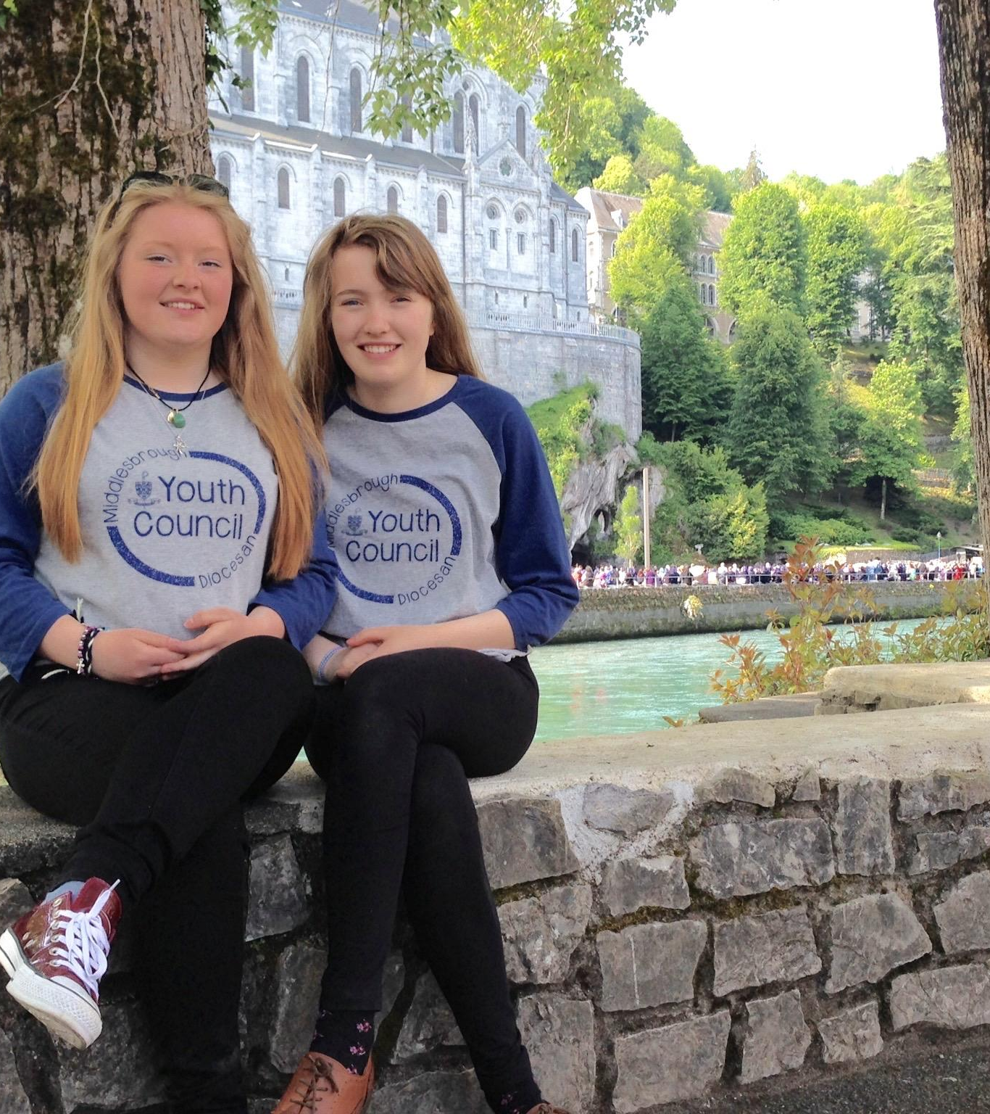
A reading from the 1st letter
of St. Peter
Each one, as a good manager of God's different gifts, must use for the good of others the special gift he has received from God. Those who preach must preach God's messages; those who serve must serve with the strength that God gives them, so that in all things praise may be given to God through Jesus Christ, to whom belong glory and power forever and ever. Amen.
The Word of the Lord
R. Thanks be to God
Notes:
St Peter calls us to take that special role in the Church by using the gifts we have received from God for the good of us. It’s a powerful invitation to not just have our faith but to live our faith. You could then offer invitation to a period of silence to reflect on what the scripture is saying to your group followed by another voice reading the scripture again.
Often when we are told to think about our gifts we struggle. We are great at finding our own faults but often find it hard to recognise God at work in us...

Slide 5
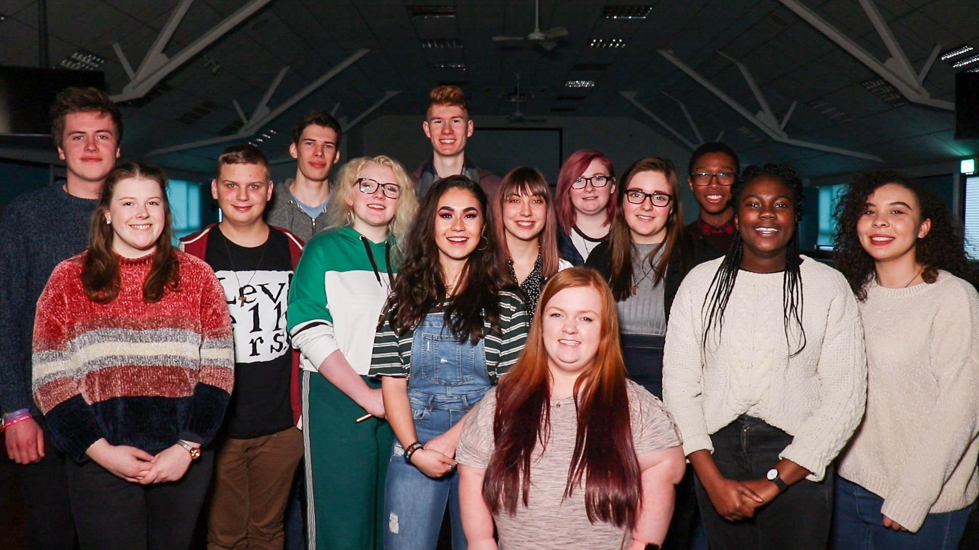
You were born significant
Notes:
Explain that you’re going to see young people who do amazing things but sometimes feel insignificant. They, like you, can find it hard to recognise their gifts.

Slide 6

Notes:
Play the video using the link above or from the National Youth Sunday Website.

Slide 7
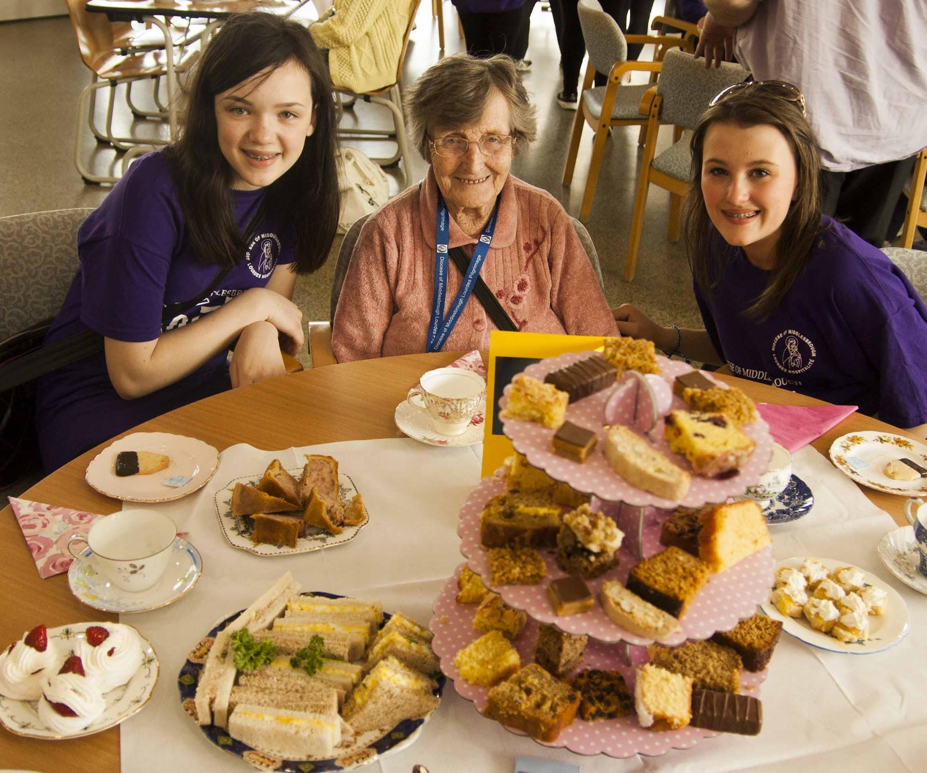
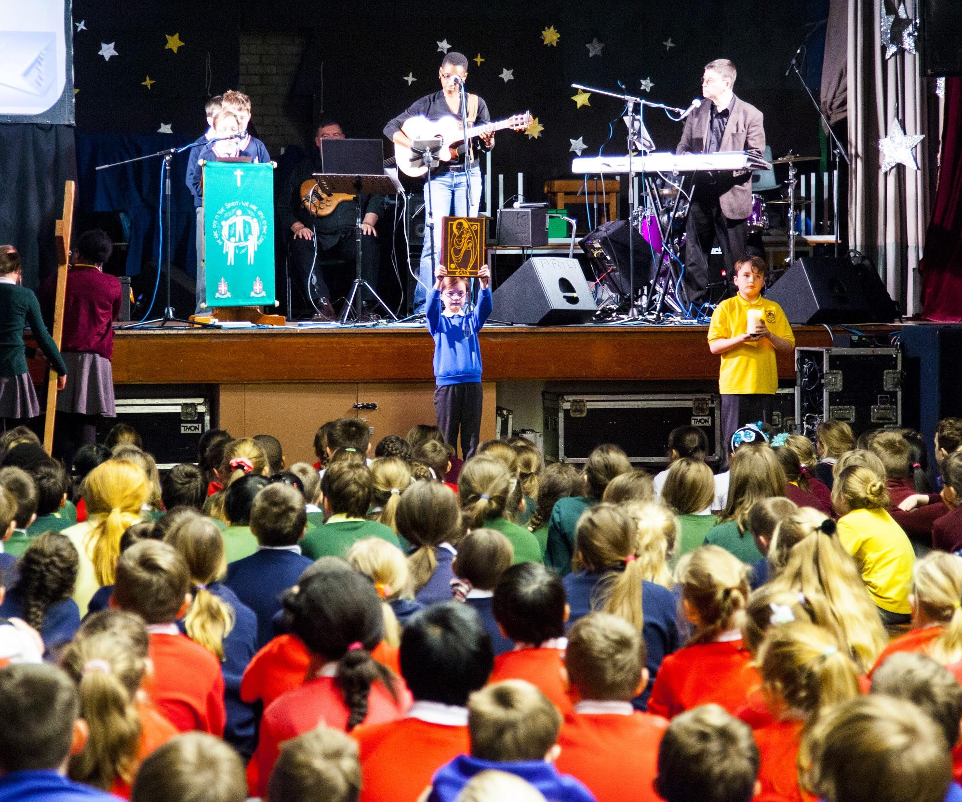
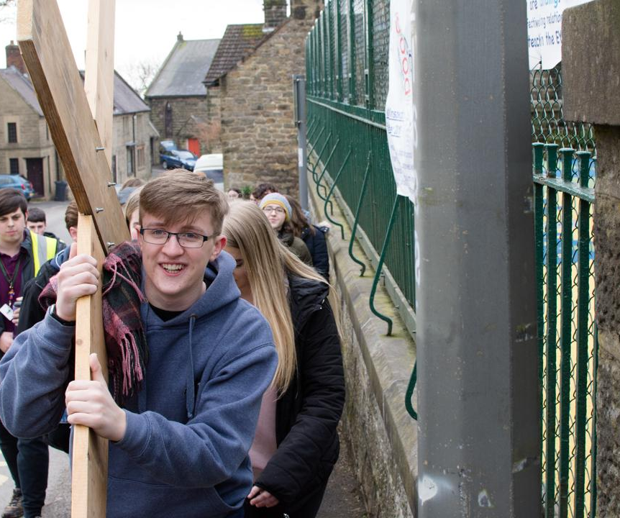
Notes:
If it’s right for the nature of your group/gathering perhaps give a few moments to reflect or share with each other the reactions to the video.

Slide 8
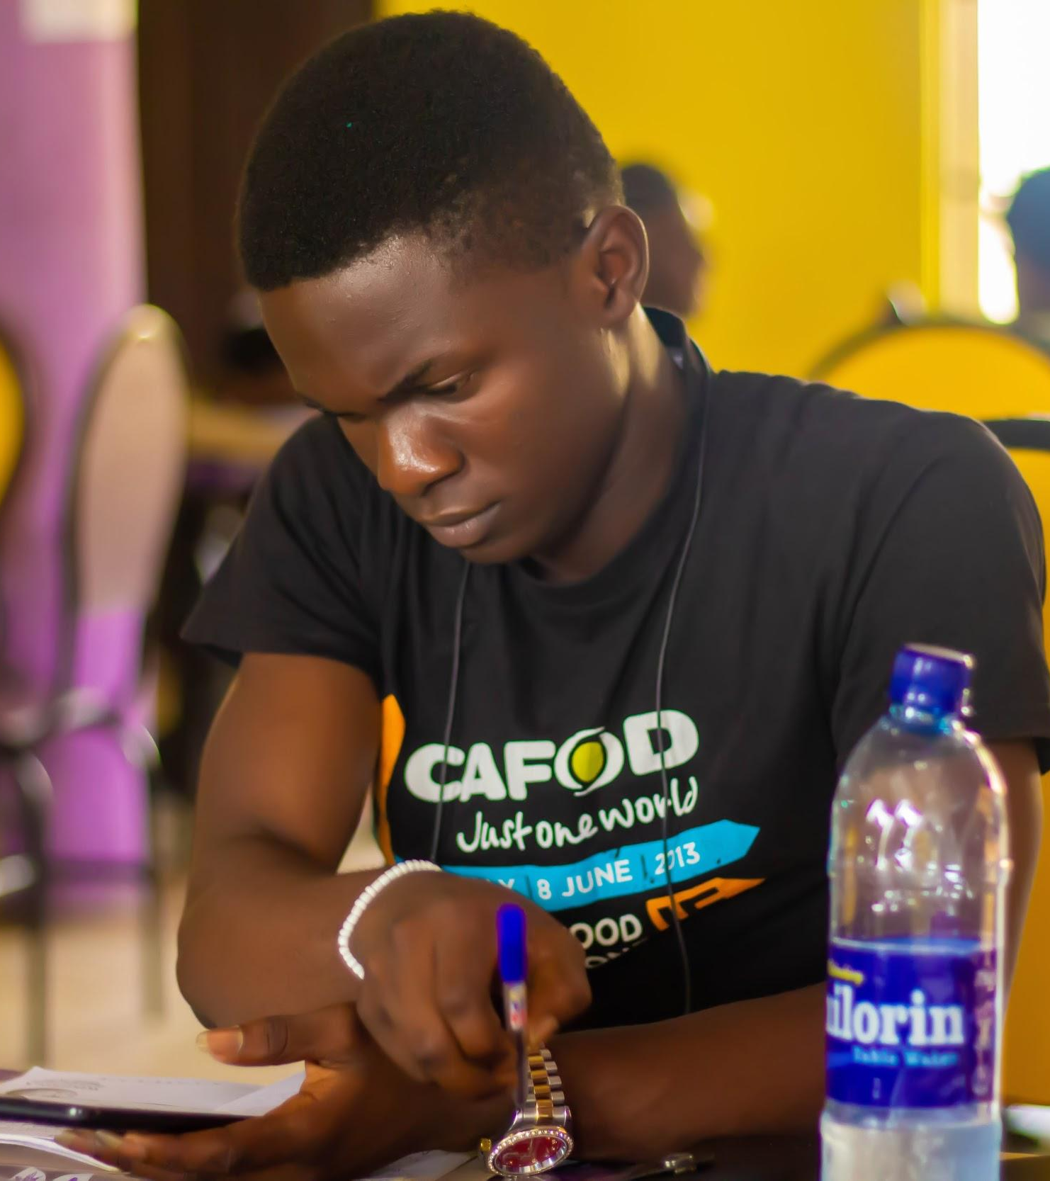
Think of a time when you have felt significant.
Think of a time when you have been able to use your gifts to impact the world around you.
Think of a person who needs you in their life
Think of a situation that needs you to do something about it.
Think about how you can be significant today.
Notes:
If its possible or practical you could invite this reflection to take place on small pieces of card or on large sheets of fabric/paper. The answers to these questions could form part of a display for your Chapel / prayer space or an image to be shared on social media. If possible you could have some reflective music and leave a pause for prayer and reflection between each statement.

Slide 9
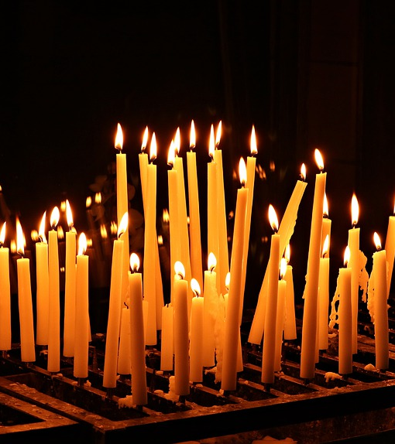
Our Father, Who art in Heaven, hallowed be Thy name;
Thy Kingdom come, Thy will be done on earth as it is in Heaven.
Give us this day our daily bread; and forgive us our trespasses as we forgive those who trespass against us; and lead us not into temptation, but deliver us from evil. Amen.
Notes:
Bring your time together by joining together in the community prayer. Notice how you never pray for yourself only the needs of others.

Slide 10
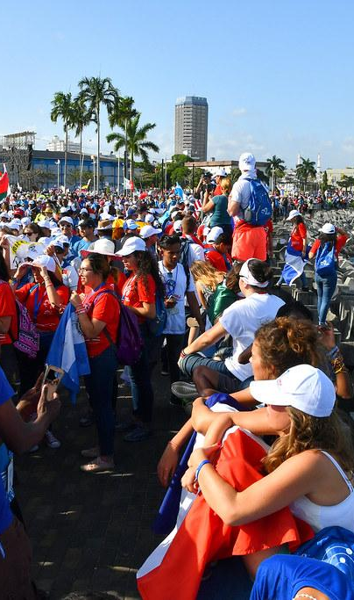

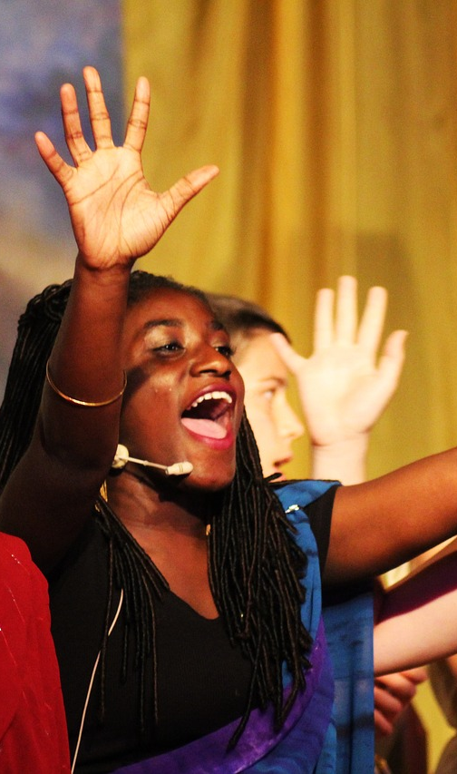
Notes:
Finish with a mission or activity. It could be to go home and share the family resources with those people at home, or to share something on your own social media to celebrate National Youth Sunday. Finish with the Sign of the Cross

