Slide 1


Notes:
Welcome to your Little Way Week Assembly. This resource is based on Saint Thérèse of Lisieux and her philosophy of doing great things for God through small acts of love. Use the notes on each slide to present this assembly to your class or school.
This presentation lasts up to 20 minutes. Though we’d recommend you deliver the whole assembly, please feel free to use the material as time and circumstances allow.
Values covered in this presentation include: mercy, faith, dignity, courage.
Little Way Week is an initiative started by Clare Ward following the visit of the relics of St Thérèse to England and Wales in 2009.

Slide 2
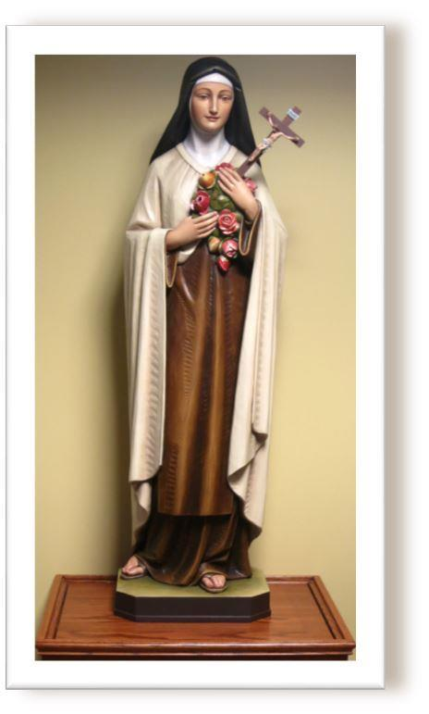
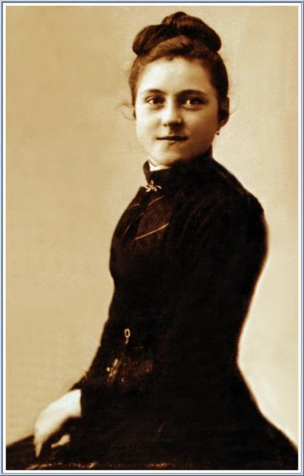
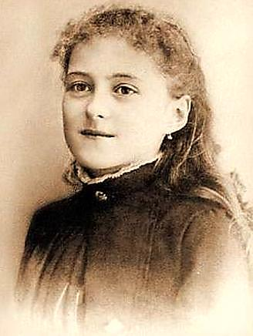
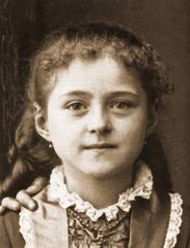

St Thérèse of Lisieux
Notes:
Tell the class that this week we are thinking about St Thérèse of Lisieux, whose feast day falls on the 1st October. Thérèse is one of the most well loved-saints internationally; most Catholic churches around the world contain a statue of her similar to the one we have on screen. You may have noticed such a statue of Thérèse in your parish too.
But in spite of her extraordinary worldwide fame, it’s important to remember that Thérèse was in reality very ordinary. Click three times to bring up images of Thérèse as a girl.
In fact the decision to make her a saint was not due to her undertaking great and heroic religious acts. On the contrary, it was due to her small acts of love for the people she encountered on a daily basis.

Slide 3
Thérèse Martin
‘I pray like children who do not know how to read, I say very simply to God what I wish to say, without composing beautiful sentences, and He always understands me.’
The diary of Thérèse Martin
Notes:
Thérèse was born on the 2nd January 1873, in France. She was a very sickly baby and due to this, Thérèse’s health remained weak throughout the rest of her life. This meant that as a child she often got her own way, refused to do household chores, and had her bad behaviour excused. All of which, understandably, annoyed her four older sisters.
Although occasionally selfish and annoying, Thérèse, like all of us, desired at heart to be a better person. From a young age she began asking God to help her to be more loving and consider the needs of others.
Turning to God for help wasn’t unusual for Thérèse or her family. They went to church together every Sunday and also prayed at home as a family during the week. Thérèse’s parents encouraged all their children to follow the example of Christ by loving and serving others, and to build a relationship with God through prayer. Click to reveal following quotation…
‘I pray like children who do not know how to read, I say very simply to God what I wish to say, without composing beautiful sentences, and He always understands me.’

Slide 4
Mercy
Mercy
Being kind, compassionate, and forgiving; most notably towards enemies and those who have caused offence.
A willingness to help anyone in need.
Notes:
Thérèse’s desire to be kinder and more considerate was tested during her time at school. For years she was bullied by an older girl in her class. But Thérèse did not allow her experiences of illness or bullying to weaken her spirit, harden her heart, or stop her in her goal to deliver God’s love to all.
On the contrary, these painful experiences made Thérèse more merciful.
Ask if anyone can explain what ‘mercy’ means. Click to reveal definition.
Thérèse’s ability to turn negative experiences into something positive, illustrates how, with God’s grace, good can be drawn from bad situations. Having the experience of being wounded and saddened, Thérèse was able to identify with the hurt and sadness of others. Having spent time prayerfully reflecting on her own behaviour and trusting that God forgave her failings, she was better able to understand and forgive the failings of others too.

Slide 5
Faith
Faith
Trust, loyalty, commitment to a person, thing, or idea.
A belief not based on proof,
but made stronger by asking questions.
Notes:
Thérèse turned to God to help her through difficult times, and due to this her faith continued to grow. In fact she provides us with a great example of what the word faith means. Click for definition of faith.
Thérèse trusted that God loved all his children unconditionally and was very close to her. As she grew she decided that she wanted to be very close to God, too. At aged 14 Thérèse told her family that she wanted to become a nun.
When Thérèse announced this to her family in 1887, it wasn’t uncommon for young Catholic women to leave their family to join other nuns in a convent, dedicating their life to prayer and service. Some of you may have had members of your family who did the same. But what was unusual was for someone at 14 to be so adamant that this is what they wanted to do with their life.
There are lots of different kinds of nuns. Some live in the outside world helping others, for example working in schools or prisons. Some nuns live enclosed; that is they stay inside their convent, working and praying together as a community for the needs of the world. Thérèse had worked out what kind of nun she wanted to be. Her goal was to become a missionary nun.

Slide 6
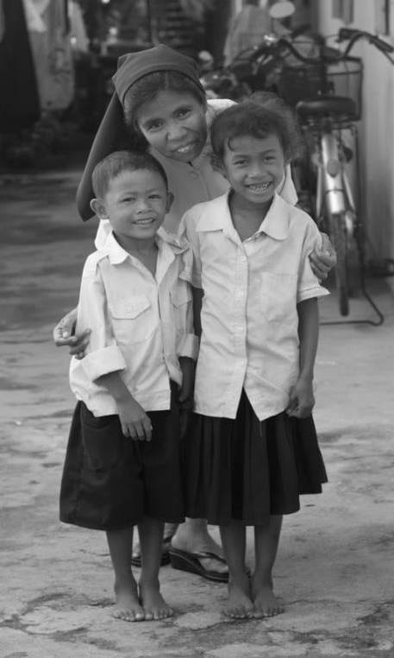
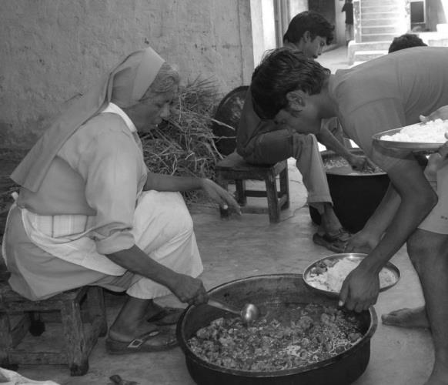
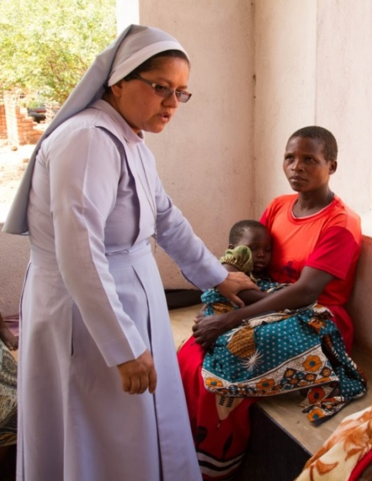
Dignity
Dignity
Human dignity is something inside every person, it cannot be taken away.
Its presence reminds us that every body is worthy of respect and should have the opportunity to live fulfilled and happy lives.
Notes:
Missionaries are committed to delivering God’s love to all people, everywhere, but their work usually takes them to impoverished communities overseas.
The title ‘missionary’ comes from the Latin word missio , which means ‘to send’’. Missionaries then, are sent out into the world to deliver the message that all people are made in the image and likeness of God. And that every single one of us, whatever our race, belief, or status, has a value beyond measure. This is what we mean when we speak of human dignity. Click to reveal definition of dignity.
Thérèse knew that Christ treated all people with dignity and that he instructed us to do the same, whether that’s the friend sitting alongside us or a stranger in a foreign land. Thérèse also understood that it is God’s desire that all people have the opportunity to live fulfilled and happy lives and that no body, no situation, no place is beyond God’s care.

Slide 7
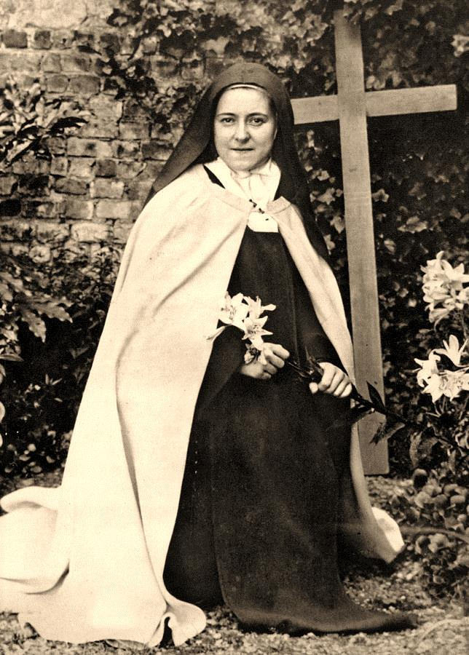
Courage
Courage
The quality of mind or spirit that enables a person to face difficulty, pain, etc., without fear.
From the Latin word ‘cor’ meaning ‘heart’.
Notes:
Due to her determination, when Thérèse was only 15 she finally became a nun; but not a missionary nun. It was felt that due to her frequent bouts of ill health she wasn’t strong enough to make long and difficult journeys to far away lands. Ironically, Thérèse, who had dreamed of travelling across the world, ended up joining a group of nuns who did not even travel outside their convent walls. Yet Thérèse was still moving away from the life she knew. And this always requires courage. Click to reveal definition of courage.
All of us have comfort zones, places and people that are familiar and make us feel safe. There are occasions when, like Thérèse, we must feel the discomfort of finding ourselves trying new things or meeting new people. With courage we can stretch outside our comfort zone and grow as people. For Thérèse, her courage was born through the faith that, with Christ, she could do all things.
Once Thérèse accepted that her goal of becoming an overseas missionary couldn’t be achieved, she didn’t get disheartened. Instead she decided that she’d find another way to do great things for God.

Slide 8
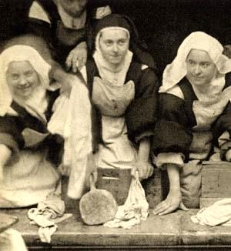
The Little Way
“Miss no single opportunity of making some small sacrifice, here by a smiling look, there by a kindly word; always doing the smallest thing right,
and doing it all for love.”
The diary of Thérèse Martin
Notes:
The way she did this was quite extraordinary. In the convent Thérèse, like the other nuns, was given lots of routine tasks to do; such as scrubbing the floor, cleaning the bathroom and washing up. Knowing that she wasn’t going to be a great overseas missionary, Thérèse decided that everything she did each day - especially the small tasks - she would do with great love. She called this her ‘Little Way’.
Thérèse’s way of loving through little acts of service may seem unremarkable, but remember that as a girl she had hated chores, was stubborn, and sought her own way. So although Thérèse’s Little Way seems unheroic, it required great determination and a willingness to put the needs of others before her own desires.
Thérèse also made a point of helping and serving nuns who had a reputation of being difficult, even cranky; nuns that other people found it hard to spend time with, never mind support. But Thérèse had made it her mission to deliver God’s love to everyone and in every situation. She wrote the following words in her now famous diary… click to reveal the quotation on screen.
“Miss no single opportunity of making some small sacrifice, here by a smiling look, there by a kindly word; always doing the smallest thing right and doing it all for love.”

Slide 9
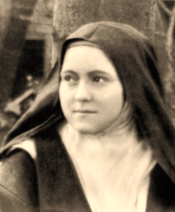
Extra-Ordinary
‘Our Lord does not look so much at the greatness of our actions, or even at their difficulty, as at the love by which we do them.’
The diary of Thérèse Martin
Notes:
Very sadly Thérèse didn’t have a long life. She was only 24 when she died in the convent of tuberculosis. Following her death the nuns couldn’t think of anything much to say about her. She just seemed to them quiet and ordinary. Then they remembered that she had kept a diary, and it was on reading this that they realised how extraordinary she had been.
During her young life Thérèse had learnt to accept that God did not require her to do anything great for him, as is clear in another line from her diary… click to reveal:
Our Lord does not look so much at the greatness of our actions, or even at their difficulty, as at the love by which we do them.
The diary revealed that Thérèse had privately made a commitment to do small everyday tasks with great love. This was her ‘Little Way’ and she followed it so quietly and humbly that nobody ever noticed.
The nuns decided to share her ideas with others and soon Thérèse’s Little Way became known throughout the world. Millions of people chose to follow it. Because of this, a few years after her death, the Pope made ordinary Thérèse Martin the extraordinary Saint Thérèse of Lisieux.

Slide 10
The Word
‘An argument arose among the disciples about which of them was the greatest.
Jesus realised the proud and arrogant intentions of their hearts. So he called a child and placed it by his side and said to them, “Truly I tell you, unless you change and become like little children you will never enter the kingdom of heaven.
Whoever becomes humble like this child is the greatest in the kingdom of heaven.”’
The Gospel of Matthew 18:1-4
Notes:
Thérèse’s life and example are largely known to us through the words she recorded in her diary. For Thérèse, words were incredibly important, particularly those she read in the Gospels.
It is by reading the Gospels that Thérèse developed her love and understanding of God through the words and actions of Christ Jesus. We can do this too, so it’s right that we finish this assembly with words that guided Thérèse and hopefully will guide us. Listen carefully to what God might be saying to you through these words.
Click to reveal scripture. You may want to ask a pupil to read this aloud.
An argument arose among the disciples about which of them was the greatest. Jesus realised the proud and arrogant intentions of their hearts. So he called a child and placed it by his side and said to them, “Truly I tell you, unless you change and become like little children you will never enter the kingdom of heaven. Whoever becomes humble like this child is the greatest in the kingdom of heaven. “ The Gospel of Matthew 18:1-4
Two years after being made a saint, the Pope appointed Thérèse as the Patron of Missionaries, because of her lifelong admiration for their work. You can follow her example by praying and fundraising for Missio – the Pope’s official charity for mission – and so help today’s missionaries share God’s love and care with those living in poverty overseas.
NOTE FOR TEACHERS /CHAPLAINS - The next slide provides details of Missio’s work, please read and consider supporting us in our efforts.

Slide 11



LITTLE WAY WEEK
is offered in partnership by Missio,
Catholic Bishops’ Conference of England and Wales
and Wednesday Word.
Notes:
This assembly was brought to you by Missio, the Pope’s official charity for overseas mission. If you would like to know more about Missio and support our important work, please visit: missio.org.uk
Missio is a Catholic charity that relies entirely on public donations; it receives no funding from the UK Government
We build Church infrastructure and support those in need, regardless of background or belief, in 157 countries.
Our work is mainly focused on areas of the greatest need. Currently these include Africa, the Indian sub-continent and Asia.
Missio Together works ‘Local Church to Local Church’, ensuring that money goes where the need is greatest
Local parish communities request global assistance for their project through their Bishop and must make a local contribution, be that through practical help or financial support
Missio money goes towards the running of every mission parish overseas as well as the Church's health, education and faith projects for children in developing countries.
Missio education welcomes feedback and suggestions on this assembly and other resources. Please contact education2@missio.org.uk

